Slide 1

Session 11-12
Communication of approved risk management strategies to required personnel
monitoring cyber security risk according to selected risk management strategies
reviewing currency of risk register

Slide 2
Recap
In the previous sessions, we discussed on how to document approved risk management strategies, making them a formal document. Once that is completed, it is important to communicate the strategies to relevant personnel.
A policy that has not been communicated to relevant personnel will not be effective.
Did you know that SM TAFE has the right to check your devices if you are connecting to the network? (that includes WiFi access)
“1.3.4 SM TAFE reserves the right to interrogate personal mobile devices that attempt to connect the SM TAFE's network, email system or use the TAFE's data push service.”

Slide 3
Communication of approved risk management strategies to required personnel
Discussion: How did you receive information about some of the risk management controls in SMTAFE?
Communication Plan
Perform a situation analysis
Define objectives
Define target audience
Identify communication media/channels
Establish communication expectations
Evaluate results

Slide 4
Communication of approved risk management strategies to required personnel
Types of communication methods:
Verbal
Non-Verbal/Interpersonal
Written
Visual
Formal communication*

Slide 5
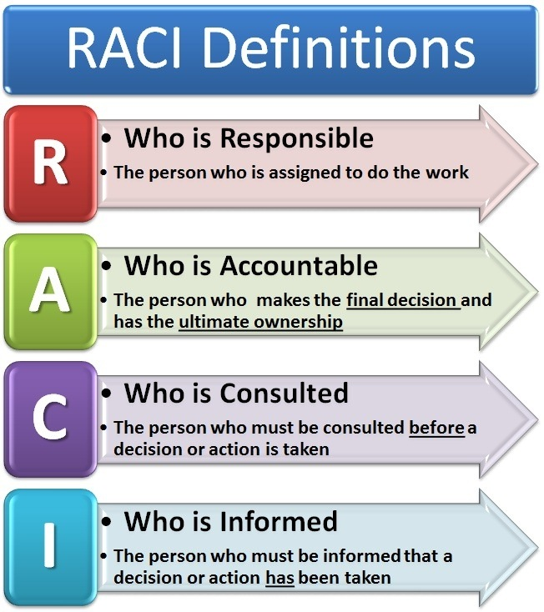
RACI Model
The RACI Model is often used within organizations to determine they type of information and communication methods to be used for respective personnel.

Slide 6
monitoring cyber security risk according to selected risk management strategies
While preventative security technology is capable of known signature-based threats, cyber security risk monitoring is required to identify more sophisticated threats that evade these controls.
Monitoring risks allows the organization to:
Evaluate if strategies are working accordingly
Detect a broader range of threats
Reduce the time it takes to respond to attacks
Comply with industry and regulatory requirements

Slide 7
Continuous Security monitoring
Continuous security monitoring solutions such as SIEMs provide real-time visibility into an organization’s security posture, constantly monitoring for cyber threats, security misconfigurations, or other vulnerabilities.
Continuous security monitoring is essential today because organizations depend on technology and data to complete key business processes and transactions.
Companies also have a greater number of independent contractors and remote workers on staff, increasing their attack surface and adding channels for data loss.
Companies may have strict policies in place, but employees continue to use applications and devices that are not approved and put data at risk.

Slide 8
SIEMs
Security solutions that correlate data sources to identify potential cyber incidents
Take into consideration various sources.
Utilises analytics and AI engines in certain cases.
Allows close to real-time monitoring of activities going on in the ecosystem.
Only as effective as the implementation.

Slide 9
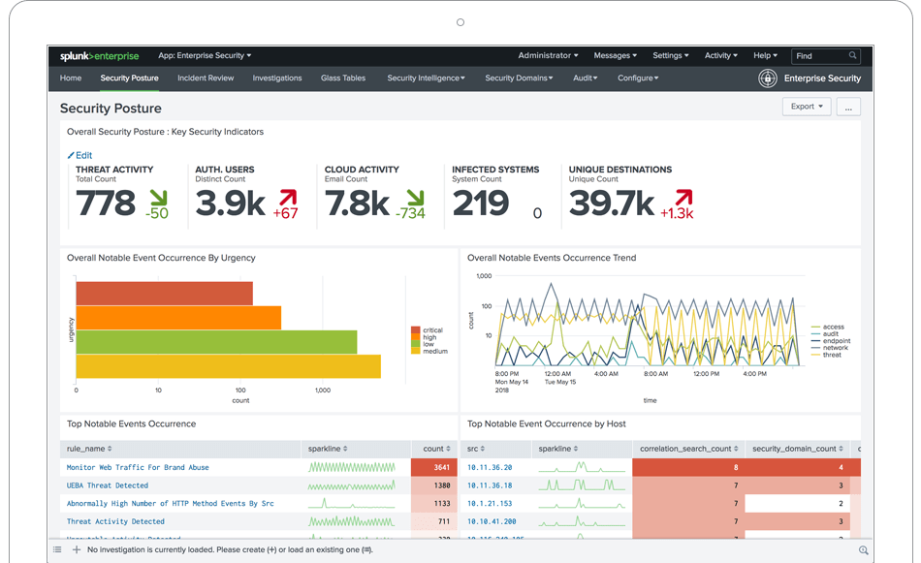
SIEMs
Splunk

Slide 10
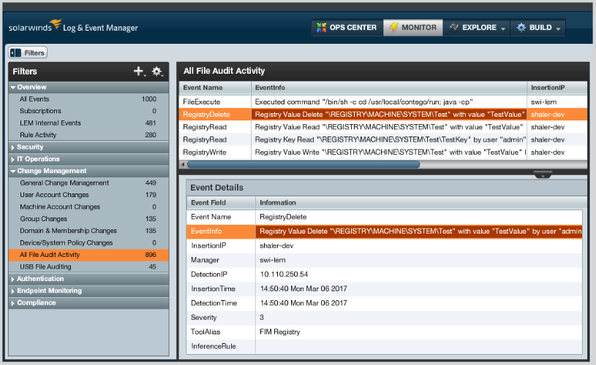
SIEMs
Solarwinds

Slide 11
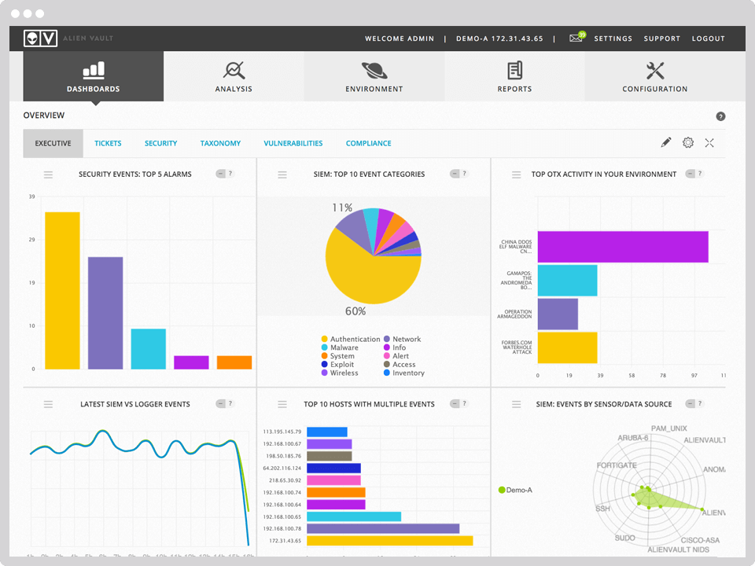
SIEMs
Alien Vault

Slide 12
Reviewing currency of risk register
Currency of risk registers must be maintained in order to ensure that strategies are effective against the relevant risks.
establish a process to monitor (continual assessment of what has been implemented) and review (a periodic assessment of the effectiveness of your actions and the environment you operate in) your risk management strategy.
This is vital because risk is not static. New risks will emerge and existing risks will disappear. Risks that you have already acknowledged may become more or less frequent, severe or relevant to your organisation. Your risk management strategy should be a fluid document that is regularly updated to take account of changes in your organisation.
Changes to your risk profile will result from changes in your organisation (for example, your focus may shift, from internal threats to cloud related threats), and from changes in the outside world that you have no control over (changes in the law, new technology and changes in society).

Slide 13
Identifying new threats and risks
The threat and risk landscape changes all the time, organisations need to monitor and review the changes periodically to ensure that the controls in place are suitable for the current landscape.
Common factors that contribute to this changes includes:
New IT asset addition to the infrastructure
Technology advancement
Changes in work procedures
New or emerging threats

Slide 14
Identifying new assets
Introduction of new assets to the infrastructure will create new risks, organizations must identify the additions in order to manage the threats and risks associated.
New projects may involve several types of assets to be added to the infrastructure.
Occasionally, it may just be an expansion of the current IT asset register whereby there is an increased number of the existing assets. (E.g. more desktops purchased for new employees)
Reminder: Assets can come in the form of hardware, software as well as intangible assets like employee's knowledge.

Slide 15
Technology advancement
As technology advances, new systems will be created, or changes will be made to existing systems. This process will inevitably introduce new threats and risks to the organisation.
Common technology advancements that creates new threats and risks may include:
New technologies/products
Software/firmware updates
Additional features to existing technology

Slide 16
Changes in work procedures
When there are changes in work procedures, the organisation should relook at their risk landscape. Changes to work procedures may increase/decrease the existing risk exposure to cyber threats.
These includes procedures that are not related to ICT as well. (Eg. A change in role or a new employee joining the organisation)
When an existing set of work procedures changes, the current cyber security strategy may not have taken the new procedures into considerations.

Slide 17
Identifying new gaps
Once changes to the risk register has been made, organisations will have to re-assess the risk due to those changes.
The extent of the assessment will vary depending on the changes.
This is also to identify new gaps introduced by the changes and updates.
There may be cases where it might be a positive impact to the infrastructure. (Instead of new gaps some changes may be enhancing the overall security)

Slide 18
Determine new controls
Same procedures of identifying controls and testing them.
Controls required depends on the new gaps identified.
This will typically involve updating of strategies unless a totally new category of IT asset was introduced and require totally new controls.
Reminder: controls will need to be tested against the new gaps to ensure efficiency.

Slide 19
Questions?

